Slide 1
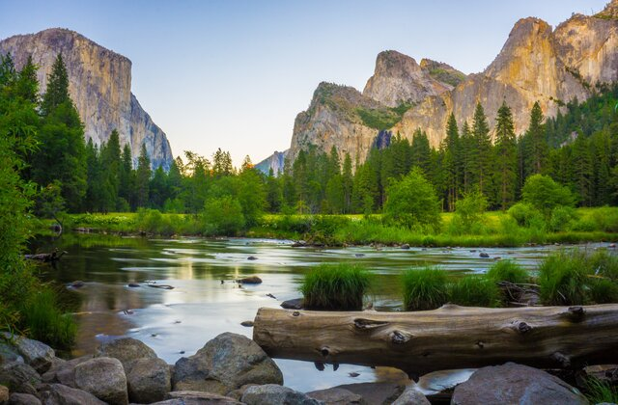
National Park NFTs
By: Michael Cordes, Chris Diaz, Bobby DiFazio, John Leelike, Troy Prata, and Griselda Ramos

Slide 2

Congratulations Chris!

Slide 3
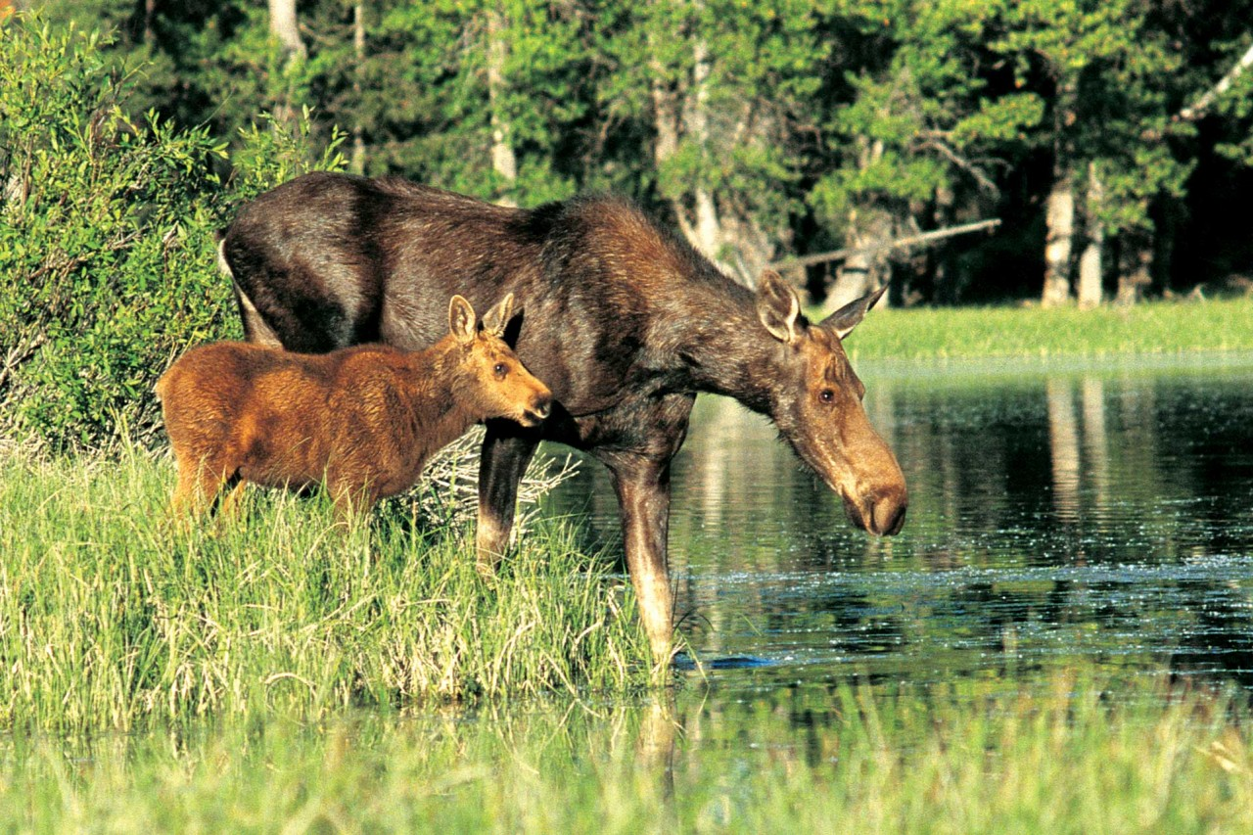
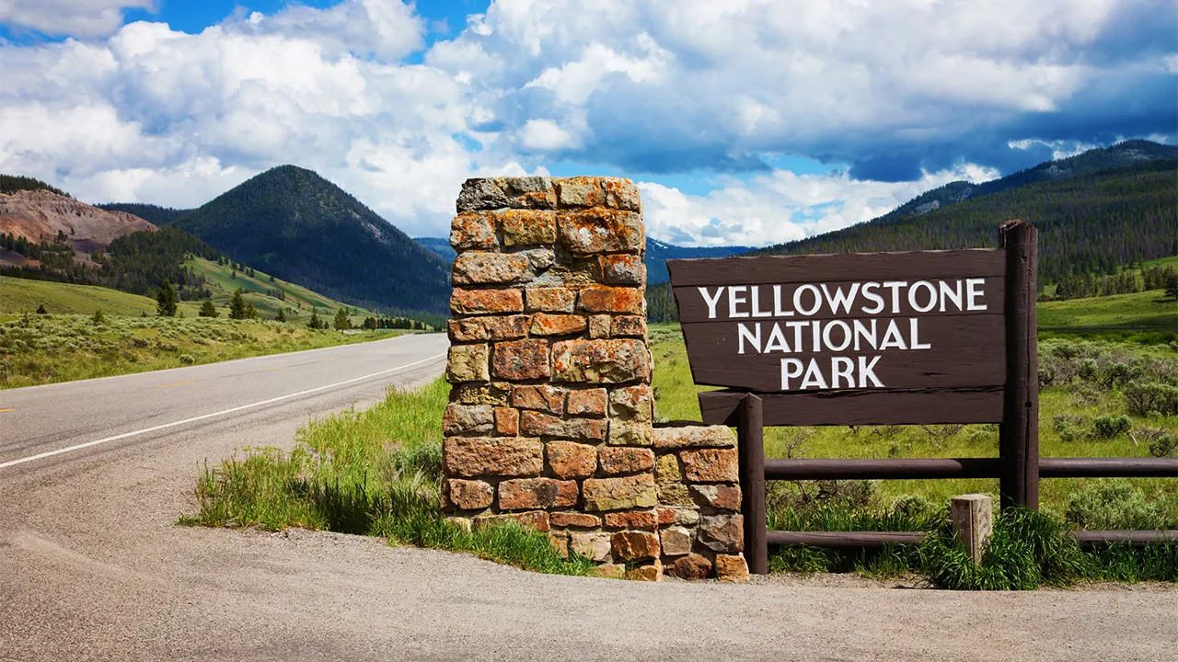
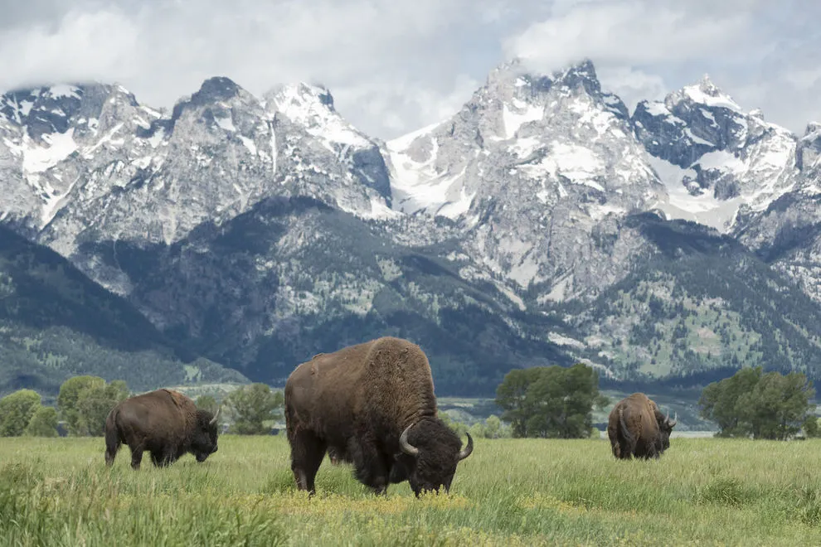
The Importance of National Parks
Conservation and Protection of the Environment and its Wildlife
“America’s Best Idea”
Protecting Biodiversity
Leisure and Well-Being
Economic Benefits
Centers For Learning

Slide 4
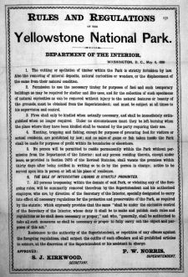
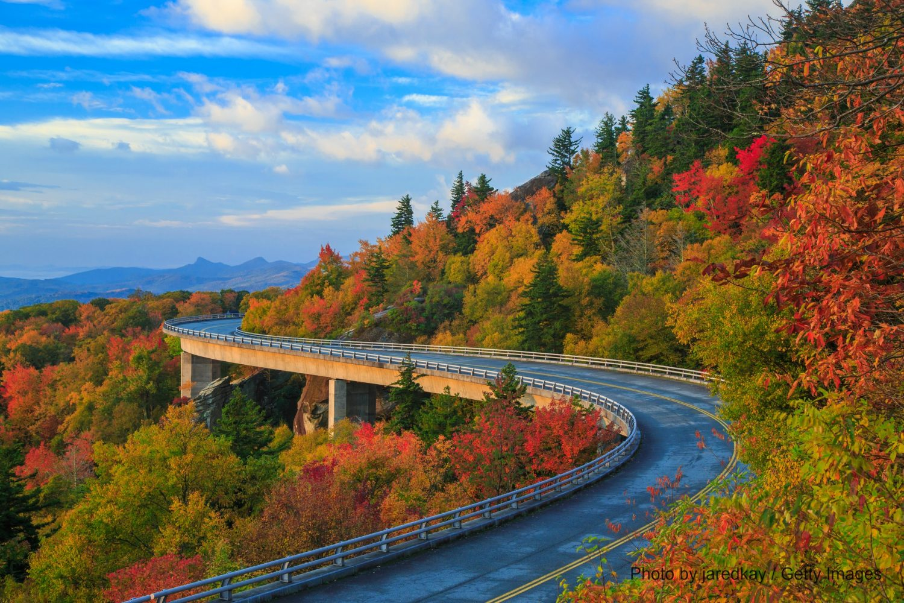
Facts About National Parks
The United States has 63 National Parks
Operated by the National Park Service, an agency of the Department of the Interior
President Ulysses S. Grant signed into law Yellowstone as the first national park in in 1872
The most visited park last year was Blue Ridge Parkway National Park, which had almost 16 Million visitors

Slide 5
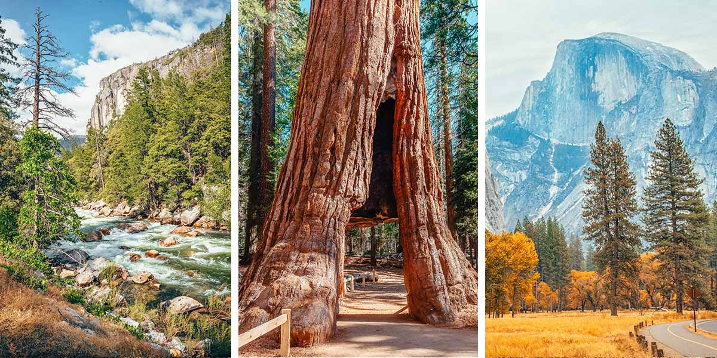
The National Parks our NFTs are Supporting
Bryce Canyon National Park - Utah
Dry Tortugas National Park - Florida
Everglades National Park - Florida
Yellowstone National Park - Wyoming, Montana, Idaho
Yosemite National Park - California
Zion National Park - Utah

Slide 6
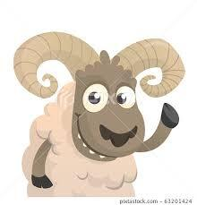


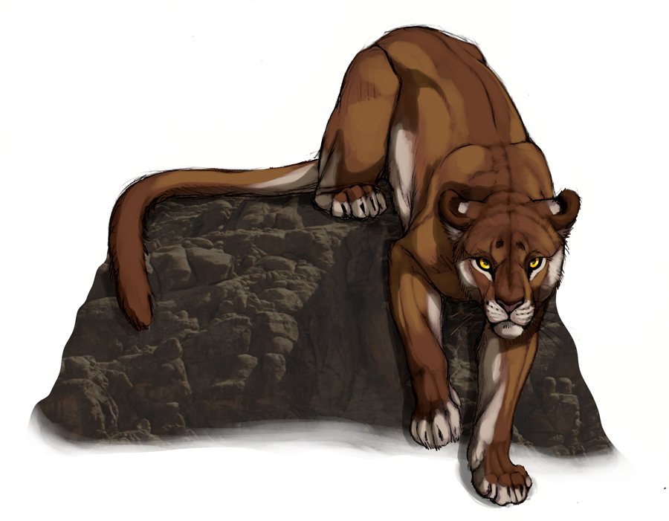
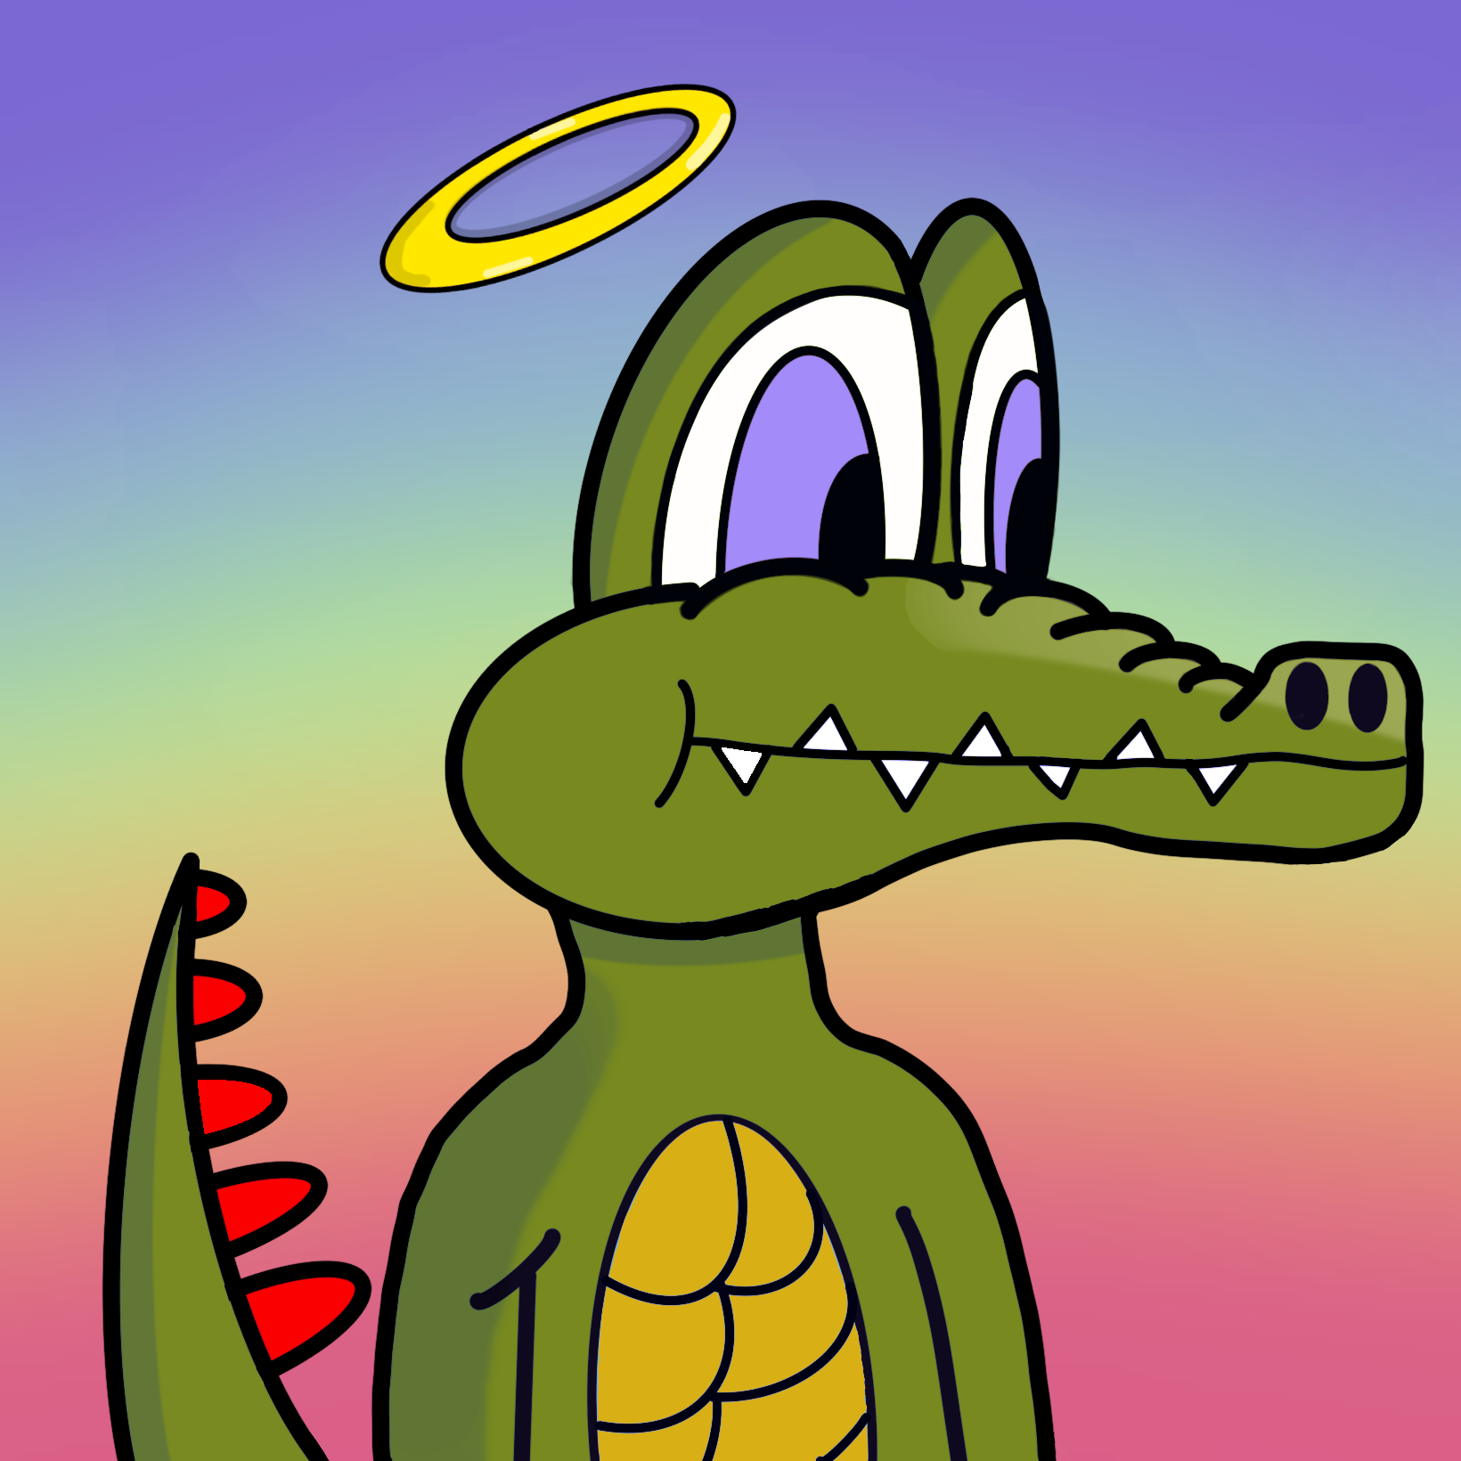

First Generation NFTs for the National Parks
Yosemite
Yellowstone
Bryce Canyon
Zion
Everglades
Dry Tortugas

Slide 7
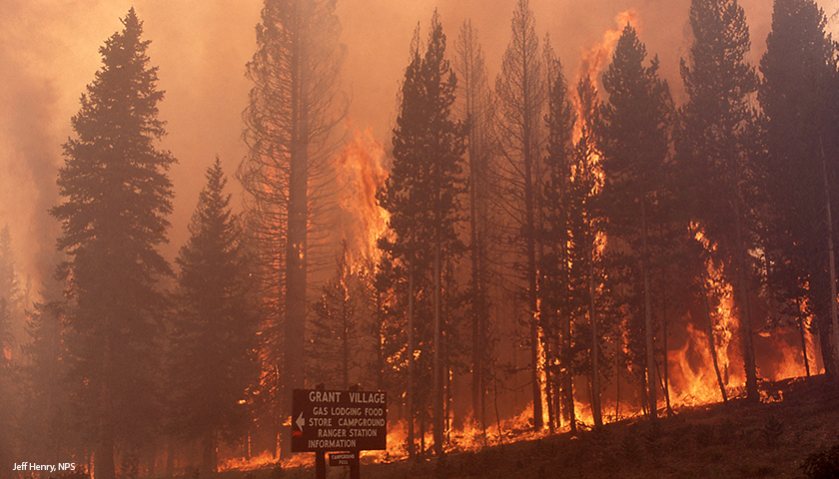
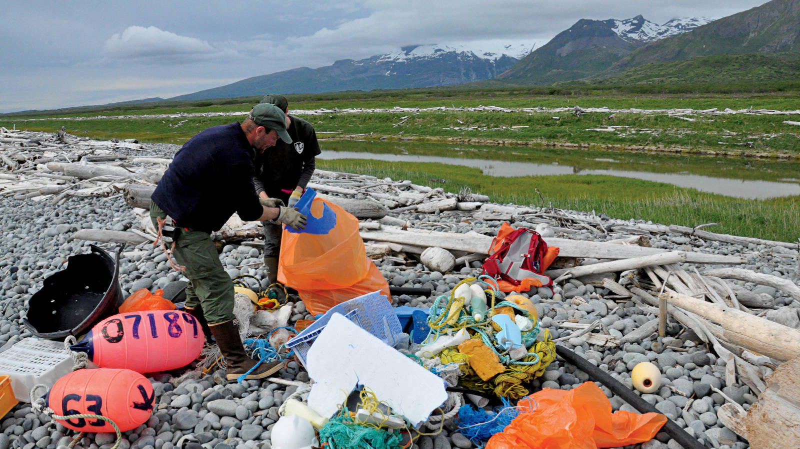
How will the NFT proceeds support the National Parks?
Wildfire damage restoration
Ecological conservation
Animal Rehabilitation
Keeping the parks clean
Educational Programs
Campgrounds, Trails, and Lodge maintenance
Historic Restoration and Preservation
Critical Ecosystem Research
Habitat Restoration and Protection
Water Conservation in Parks
Energy Smart Parks

Slide 8
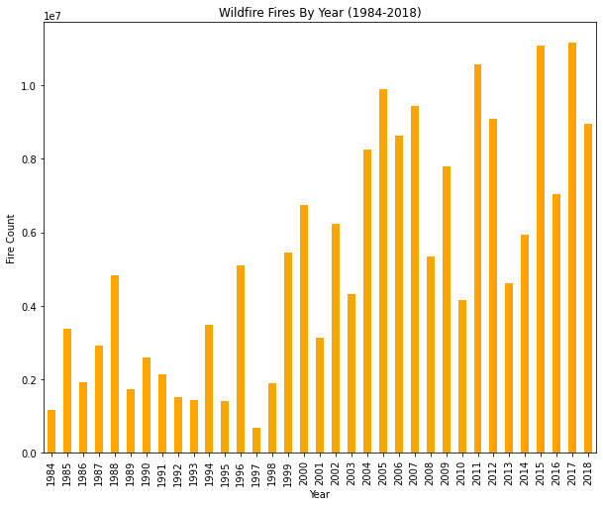
Analysis/Techniques
Increase in wildfire season length, wildfire frequency, and burned area.
Yellowstone, Glacier and Rocky Mountain National Parks are predicted to have the most significant increases in wildfires of all U.S. parks.
In 2019, 350,000 acres of Yosemite Park were destroyed

Slide 9
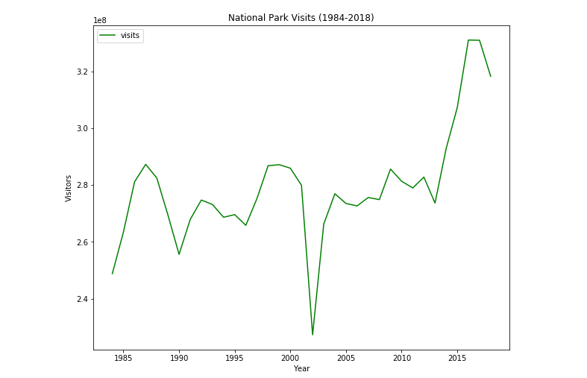
Analysis/Techniques Continued

Slide 10
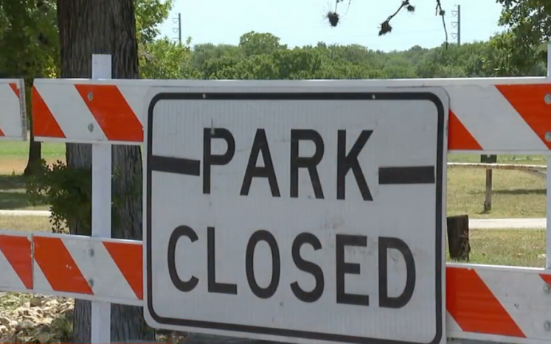
Unanticipated Problems
IPFS Functionality as we wanted
Google Collab vs Jupyter Notebook
Building NFT Marketplace
Time constraints

Slide 11
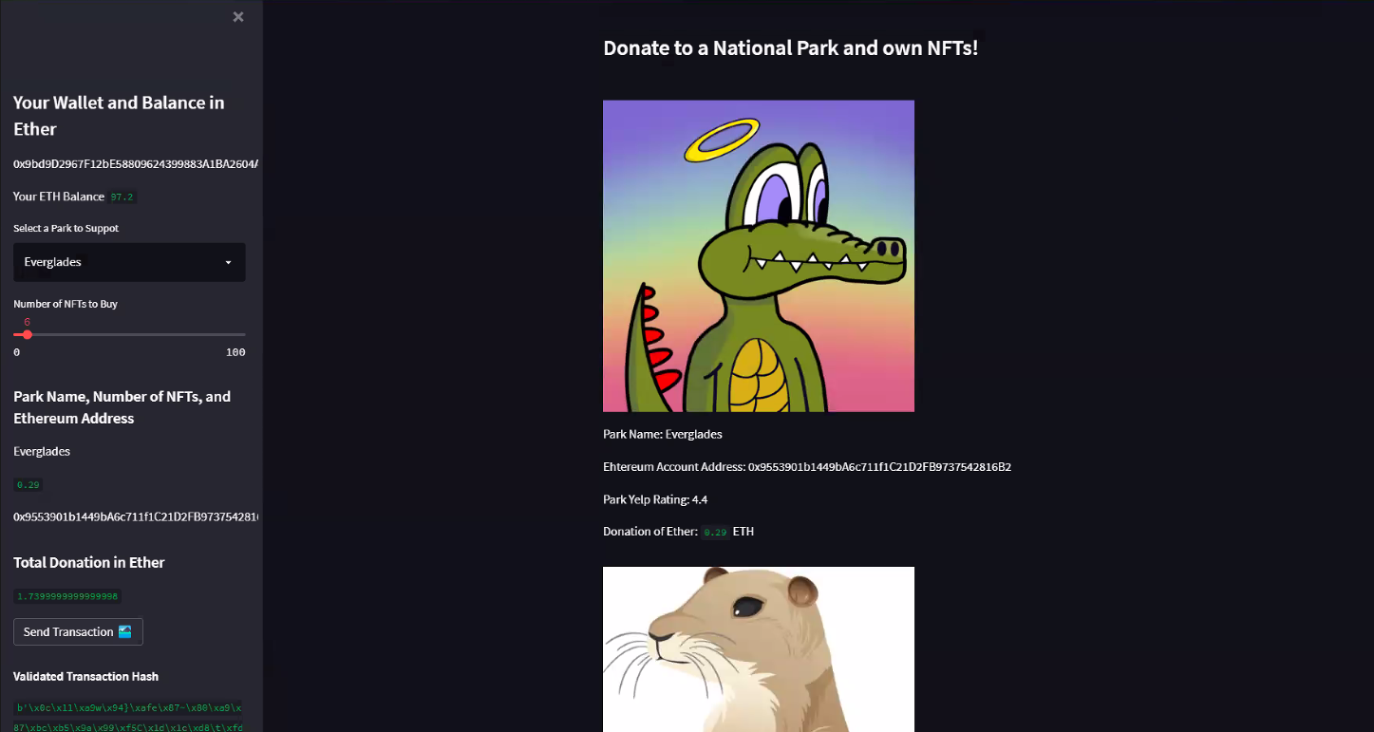
Results/Conclusions

Slide 12
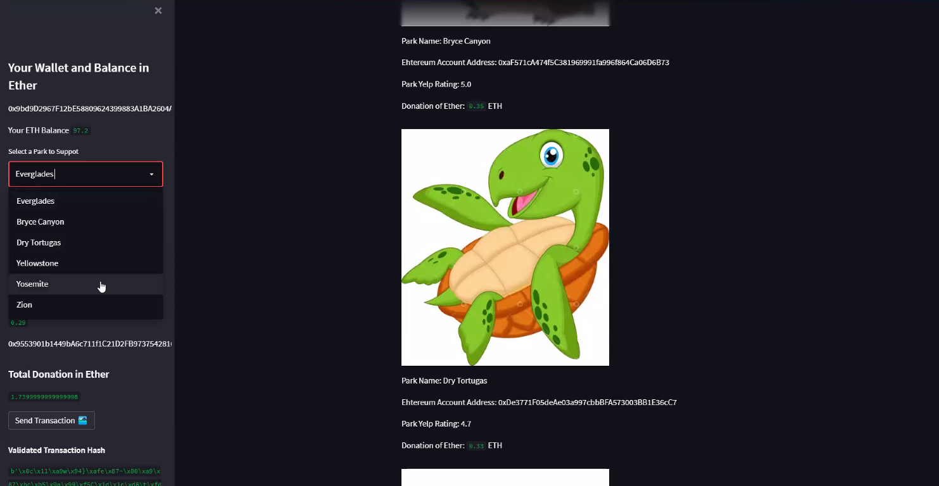
Results/Conclusions Continued

Slide 13
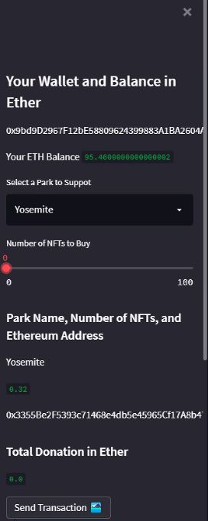
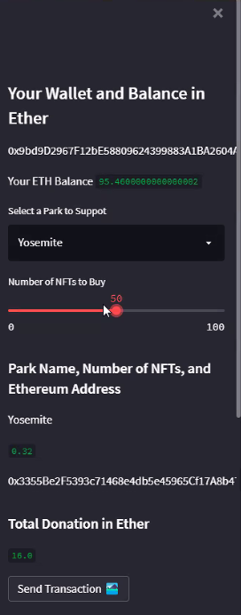
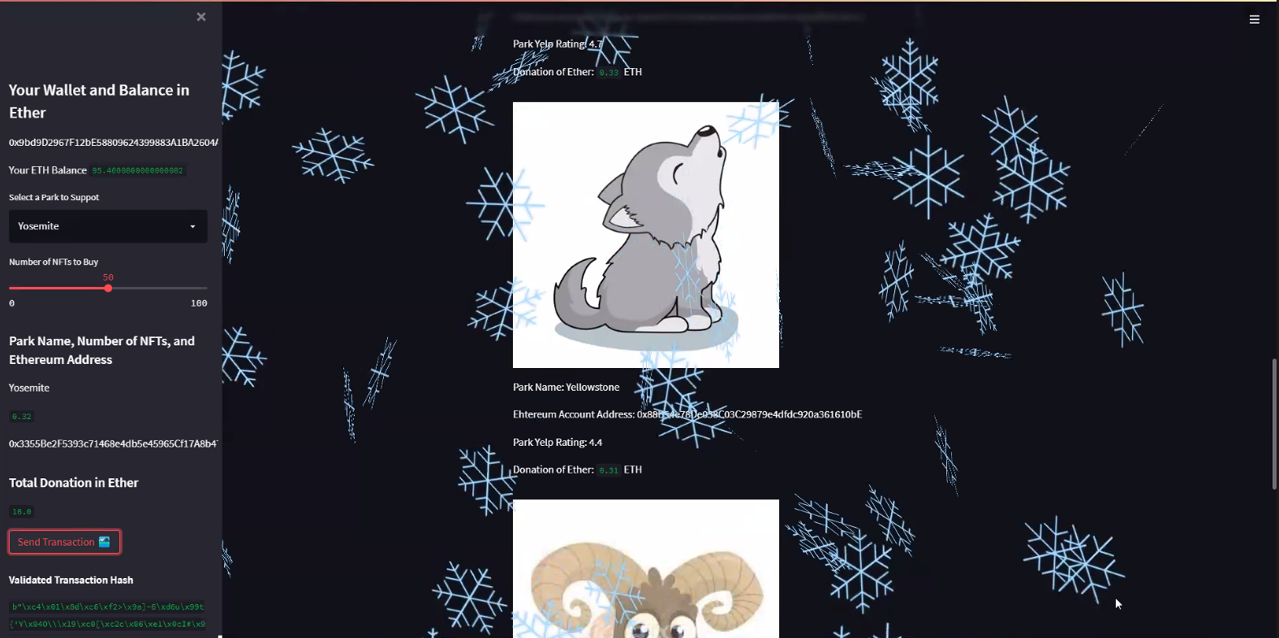
Transaction Results

Slide 14
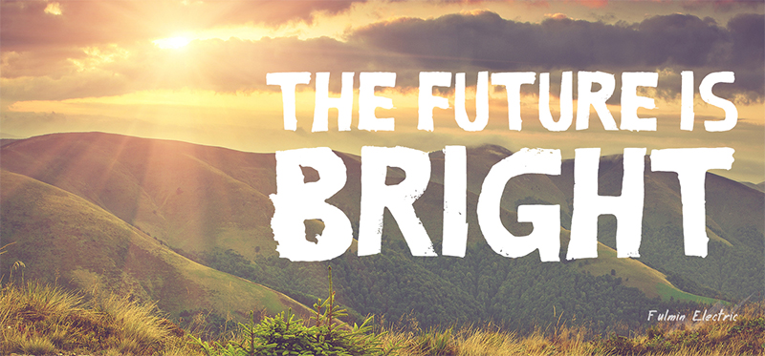
Next Steps for our NFT Project
Include more parks in our marketplace
Expand upon our NFT collection
Create memberships to do activities in the parks as if the NFTs are tickets to gain access
Create a Discord, Reddit, Instagram and other social media platforms to promote awareness
Partner with celebrity influencers to promote our mission
Showcase how we made a difference in the parks and how we used the money
Create volunteer opportunities for people who want to get involved

Slide 15
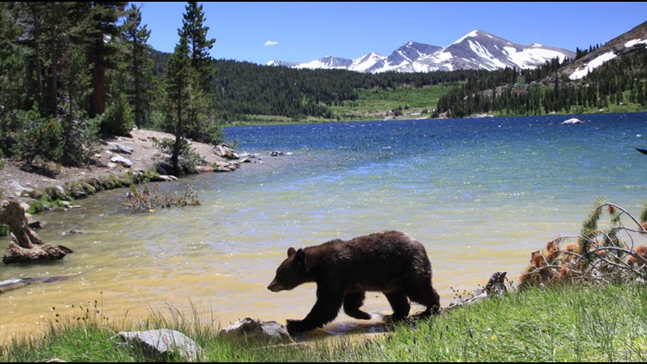
Thank you! Any Questions?

